Slide 1
My Project Presentation
By Miss Lolia Green-Okoroh

Slide 2
What I have learnt
I have learnt how to build small websites, use UI(User Interface) designs, and how to solve little problems with code.

Slide 3
How I can apply what I have learnt
What I have learnt can be applied in many ways. Some are to solve problems,

Slide 4
Tools and Packages I have used
Thunkable
Github
Figma
Flask
Bootstrap etc.

Slide 5
Assignment Completion Rate
90% out of 100%

Slide 6
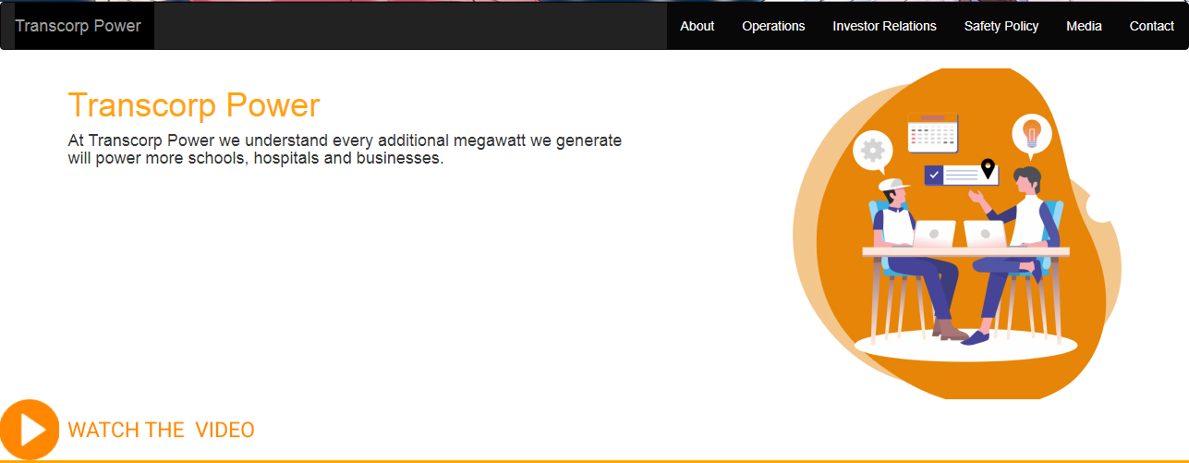
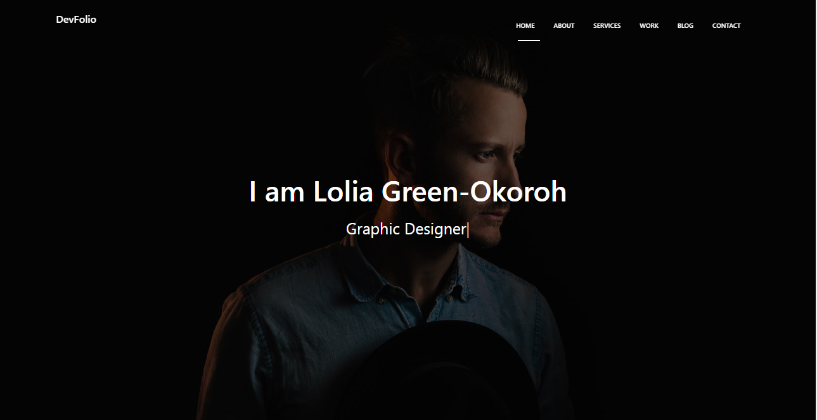

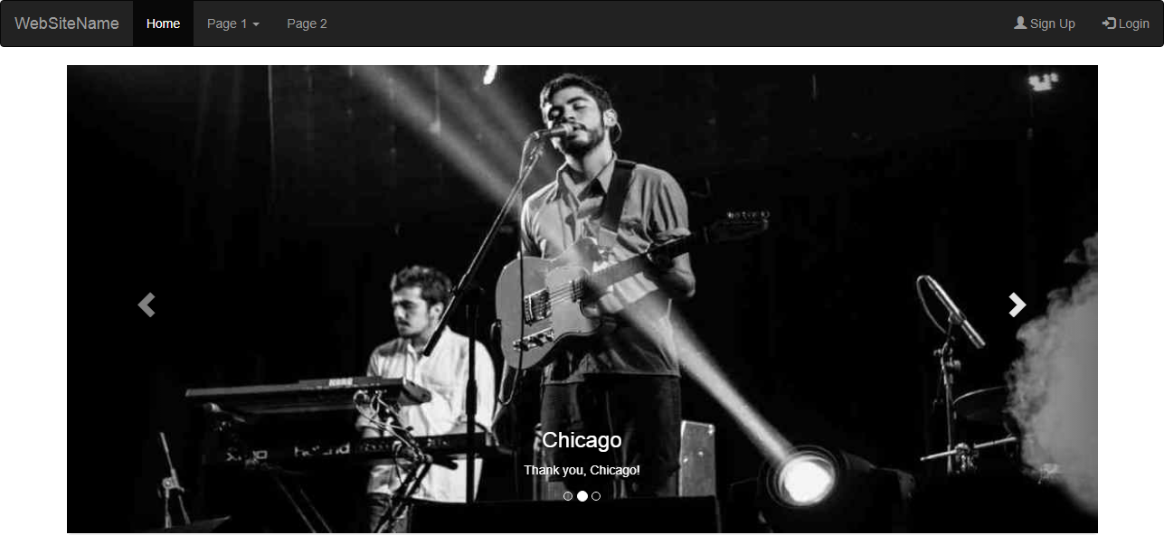
Website of wonder

Slide 7
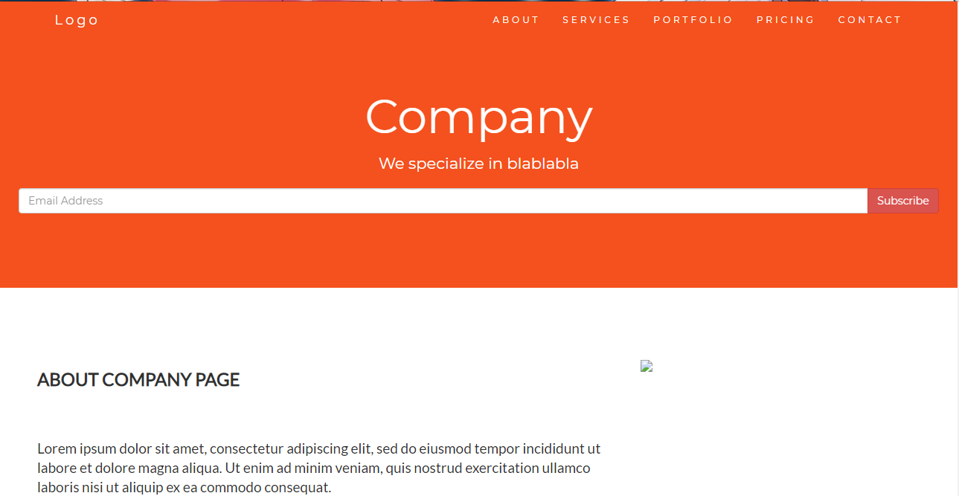
Transcorp power

Slide 8
Github Link

